Slide 1

Modern Analytics Academy “Vignettes”
Follow up to Modern Analytics Academy: https://aka.ms/maa
Topical sessions that addresses:
New features and how to use them
Frequent questions we receive
Updates to a previous session
Pardeep Singla
Cloud Solution Architect

Slide 2
Modern Analytics Academy “Vignettes”
Solution Accelerator for Data Analytics on Azure
https://aka.ms/maa
Pardeep Singla
Cloud Solution Architect

Slide 3
Agenda
Overview & Use Cases
Demo
Solution Accelerators for Data Analytics on Azure

Slide 4
Overview
Solution accelerator is an end-to-end solution that contains code, notebook, and pipeline. Customers can use solution accelerators to quickly build data products and realize data's value.
Solution Accelerators are open-source projects hosted on GitHub.
Holding repositories of resources and information that simplify and accelerate problem solving through the implementation of technology.

Slide 5
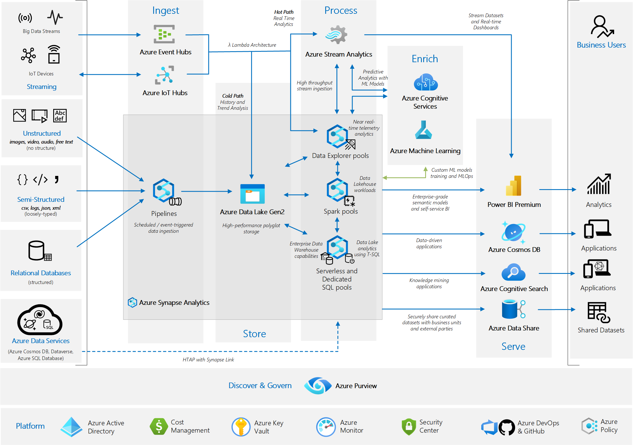
Solution Accelerator for Data Analytics on Azure
Analytics end-to-end with Azure Synapse.

Slide 6
Potential Use Cases
Establish a data product architecture, which consists of a data warehouse for structured data and a data lake for semi-structured and unstructured data. You can choose to deploy a single data product for centralized environments or multiple data products for distributed environments such as Data Mesh.
Integrate relational data sources with other unstructured datasets, with the use of big data processing technologies.
Use semantic modeling and powerful visualization tools for simpler data analysis.
Share datasets within the organization or with trusted external partners.
Implement knowledge mining solutions to extract valuable business information hidden in images, PDFs, documents, and so on.

Slide 7
Use Cases for Partners
Solution accelerator for Demo.
Customizing and adding in their existing solution.
Implemented into products (ISVs) as best practices for security/compliance
Proof of Concepts

Slide 8
References
Github link for Azure end to end Synapse solution accelerator
https://github.com/Azure/azure-synapse-analytics-end2end
Microsoft Architecture Center documentation for “end to end synapse solution accelerator”
Cloud-scale analytics data products in Azure - Cloud Adoption Framework | Microsoft Learn

Slide 9
Agenda
Overview
Use Cases
Demo
Solution Accelerators for Analytics

Slide 10
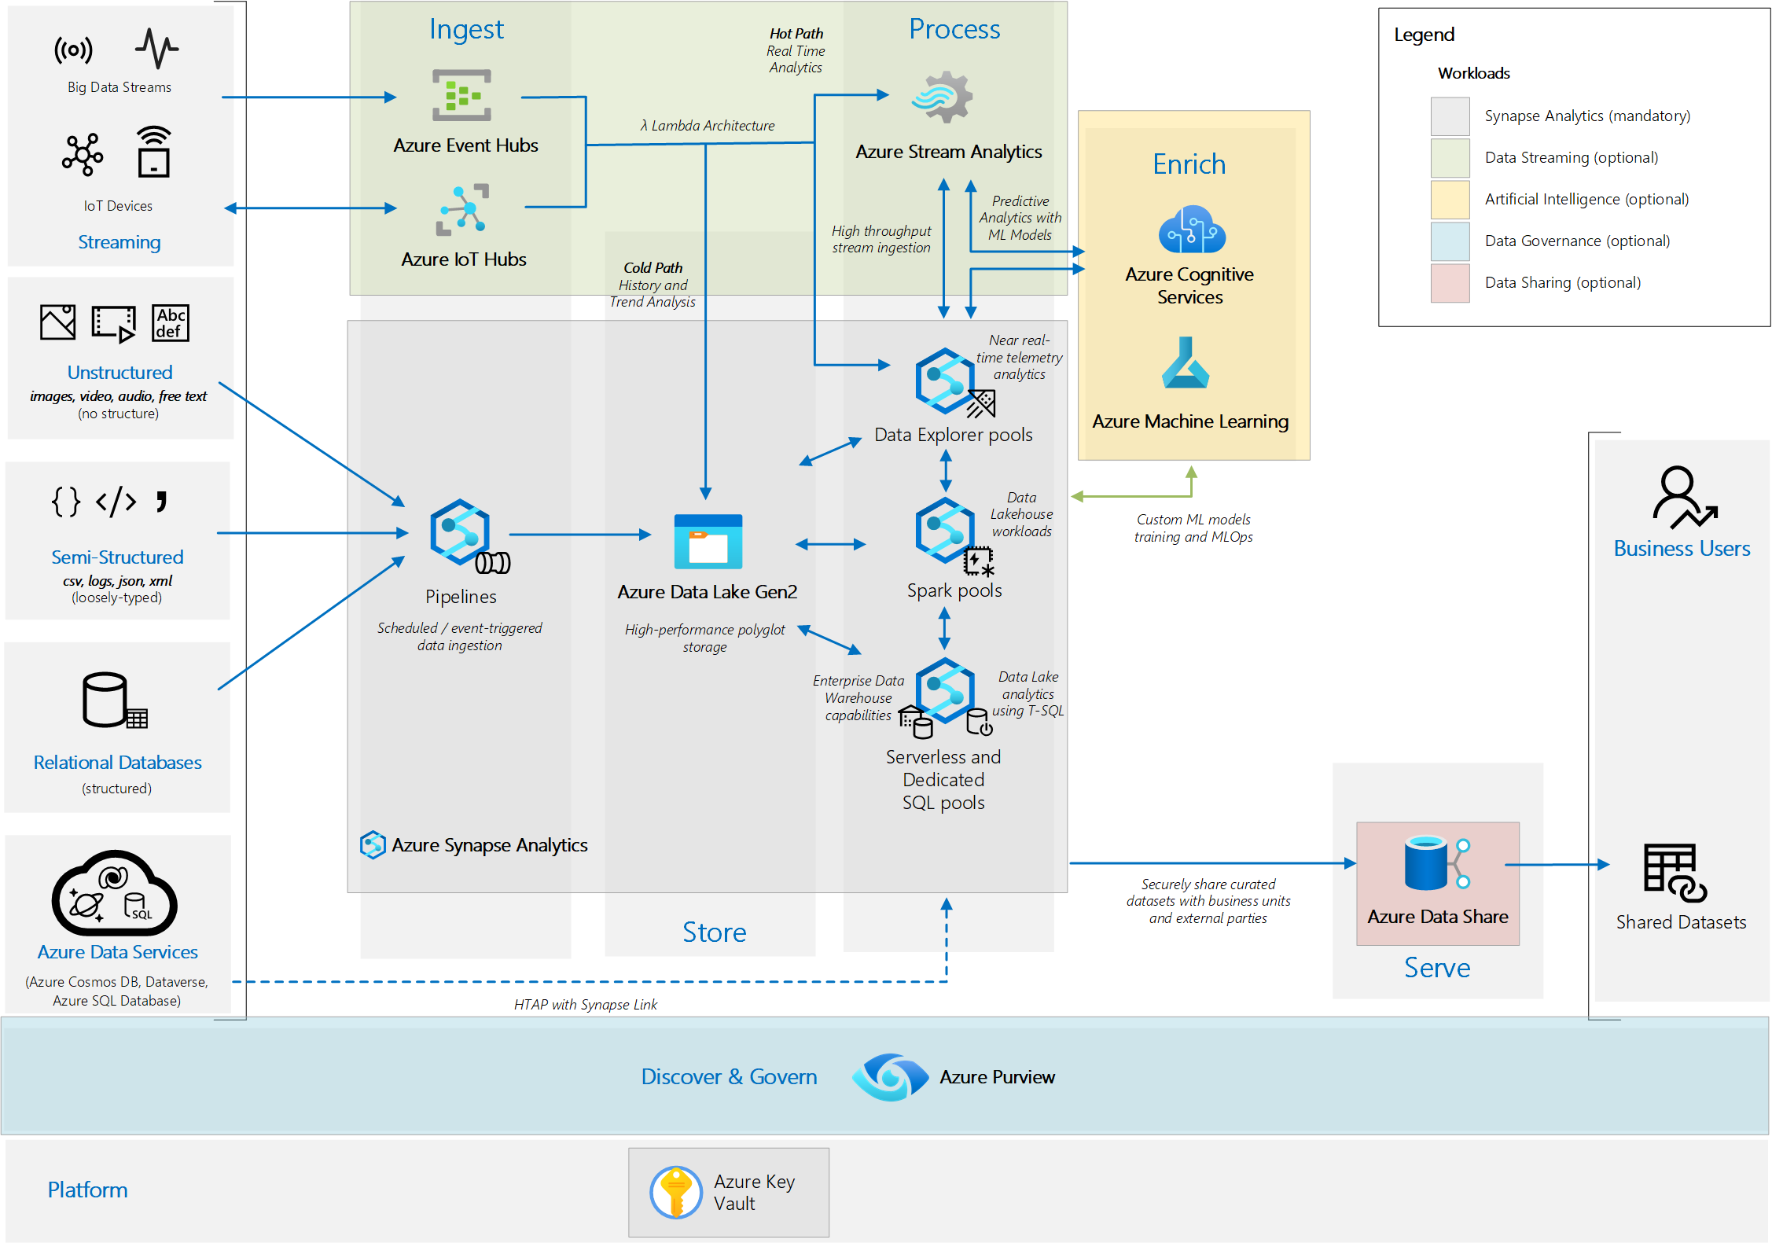
Solution Accelerators for Data Analytics on Azure– Demo
Scope of Solution Accelerator Deployment

Slide 11
Supported Regions
Currently the following regions support the deployment of all services:
Southeast Asia
Australia East
Canada Central
North Europe
West Europe
Central India
UK South
East US
East US 2
South Central US
West US 2

Slide 12
Required Resource Providers
Microsoft.Purview
Microsoft.MachineLearningServices
Microsoft.ContainerRegistry
Microsoft.Network
Microsoft.DataShare
Microsoft.Authorization
Microsoft.CognitiveServices
Microsoft.ManagedIdentity
Microsoft.KeyVault
Microsoft.Storage
Microsoft.StreamAnalytics
Microsoft.Devices
Microsoft.Insights
Microsoft.EventHub
Microsoft.DocumentD

Slide 13
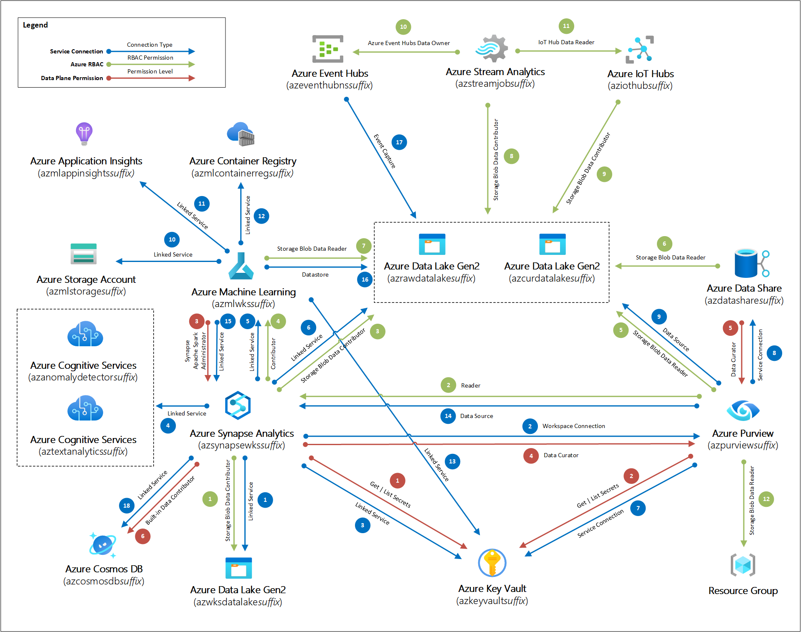
Integration and Permissions

Slide 14
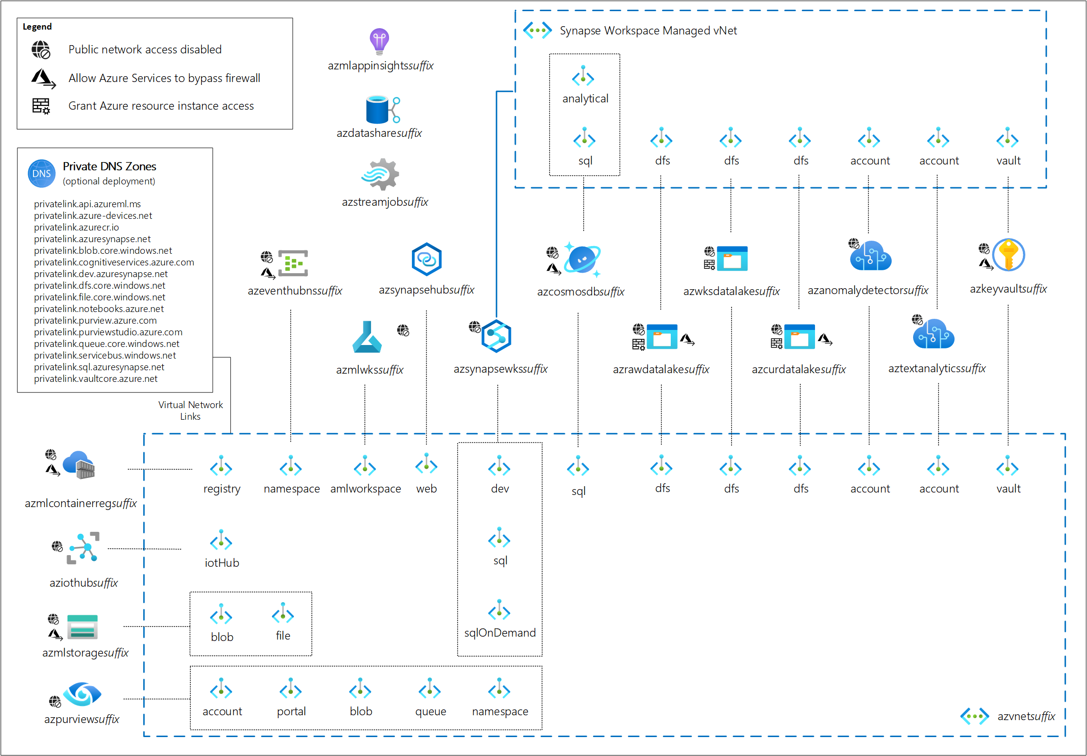
Vnet Integrated Environment

Slide 15
Thank you!
Modern Analytics Academy “Vignettes”
Solution Accelerator for Data Analytics on Azure
https://aka.ms/maa

